Slide 2
Object Tracking

Slide 3
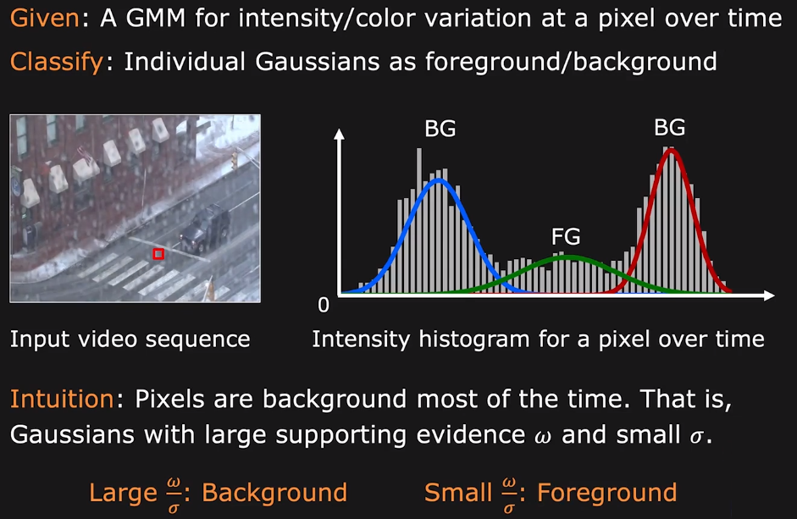
Background Modeling with GMM

Slide 4
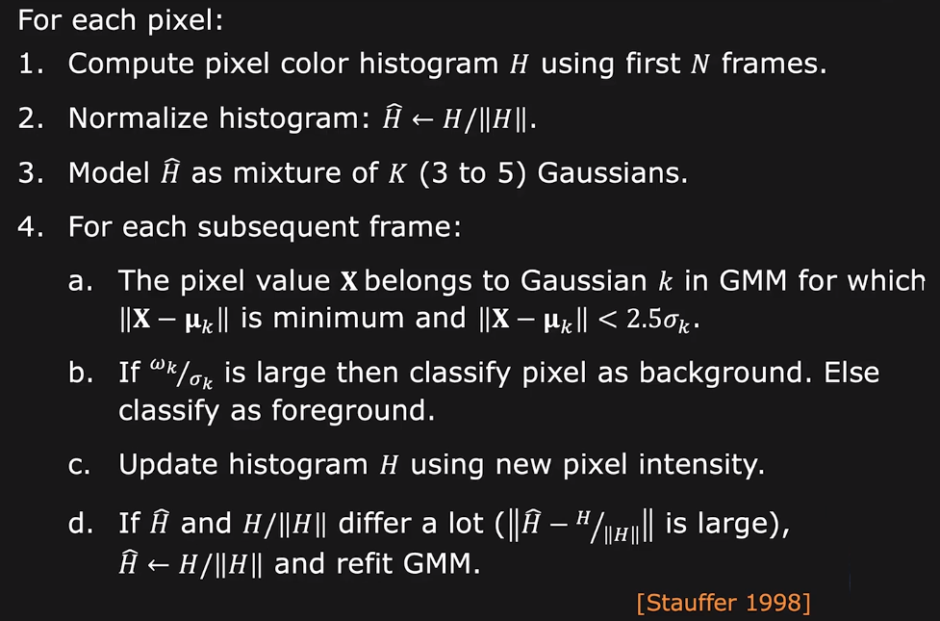
Change Detection using GMM

Slide 5
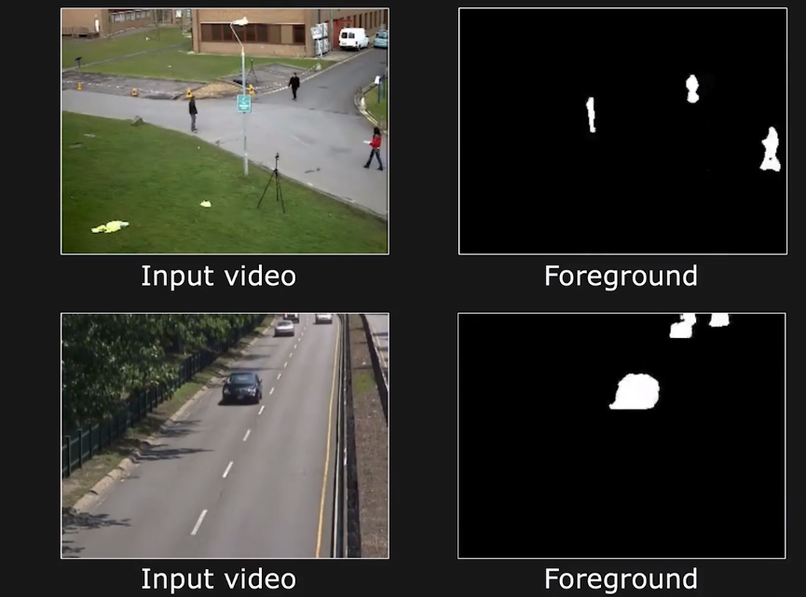
Adaptive GMM based Change Detection

Slide 6
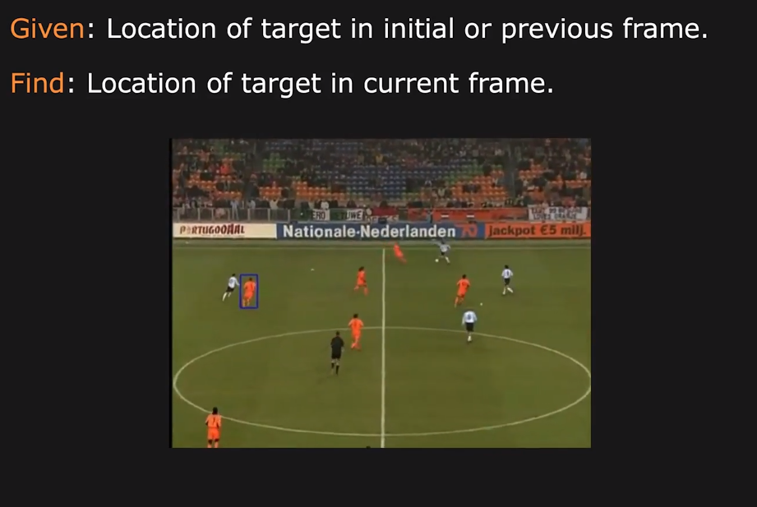
Object Tracking

Slide 7
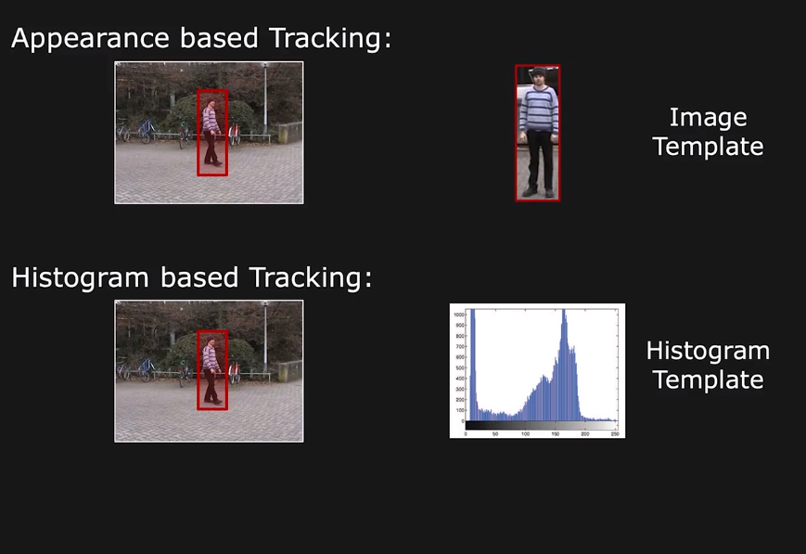
Target Templates for Tracking

Slide 8
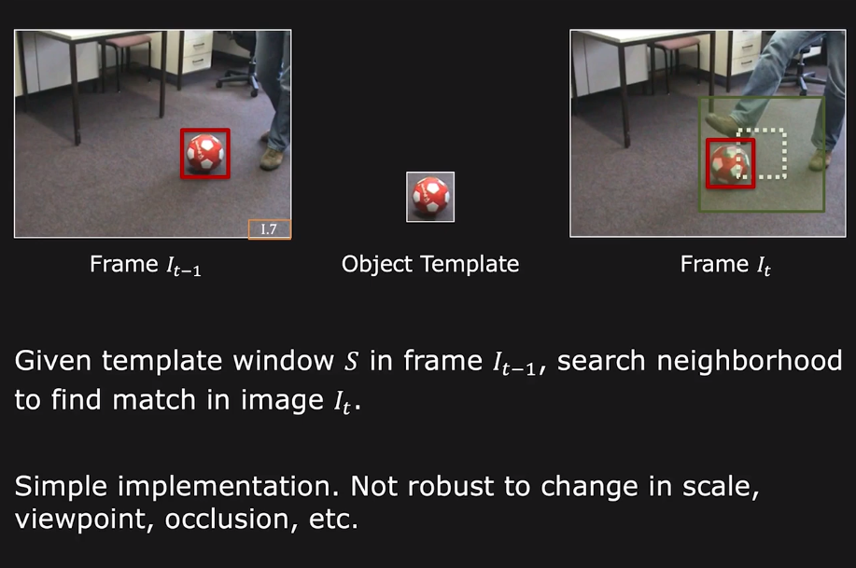
Tracking using Appearance Matching

Slide 9
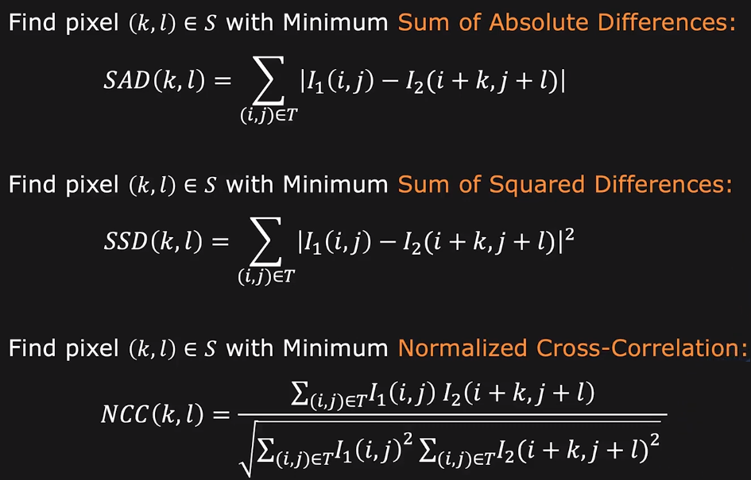
Similarity Metrics for Pattern Matching

Slide 10
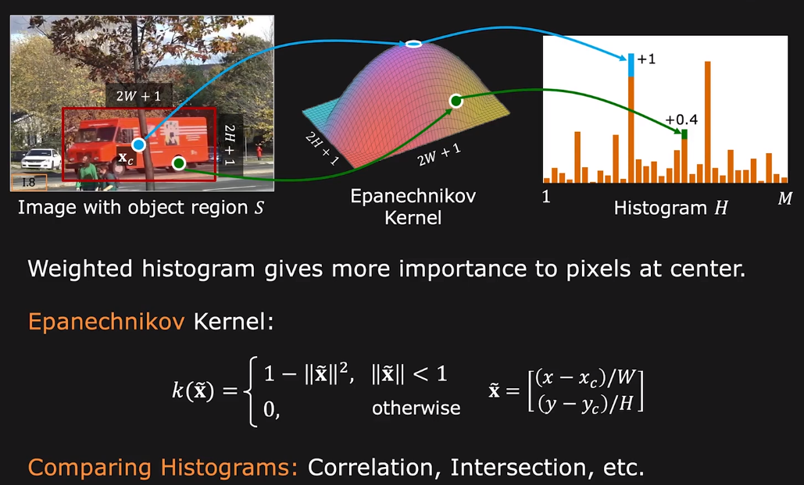
Computing Weighted Histogram

Slide 11
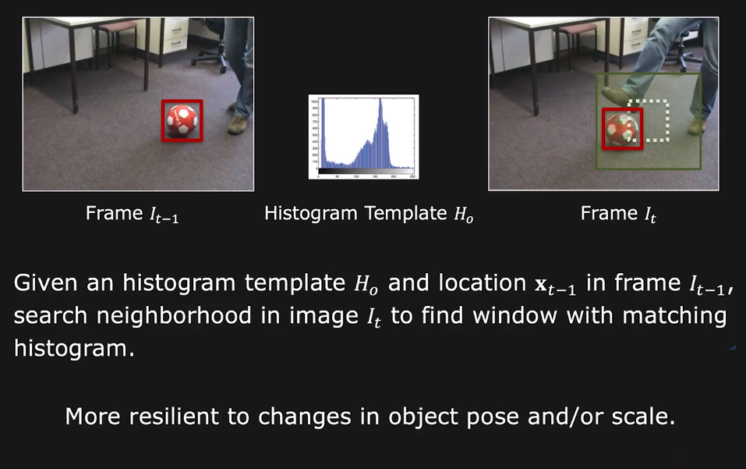
Tracking using Histogram Matching

Slide 12
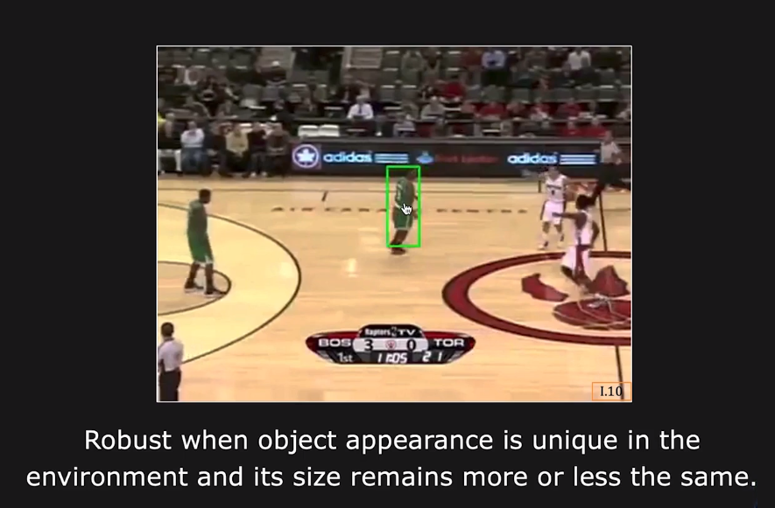
Histogram Based Tracking: Results

Slide 13
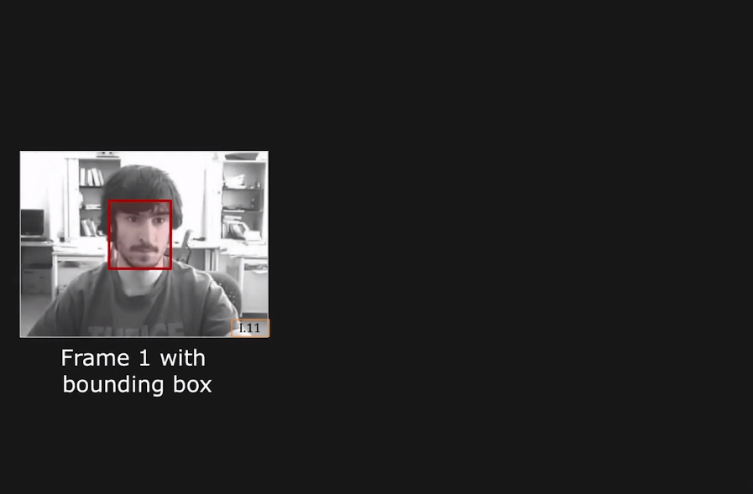
Tracking by Feature Detection

Slide 14
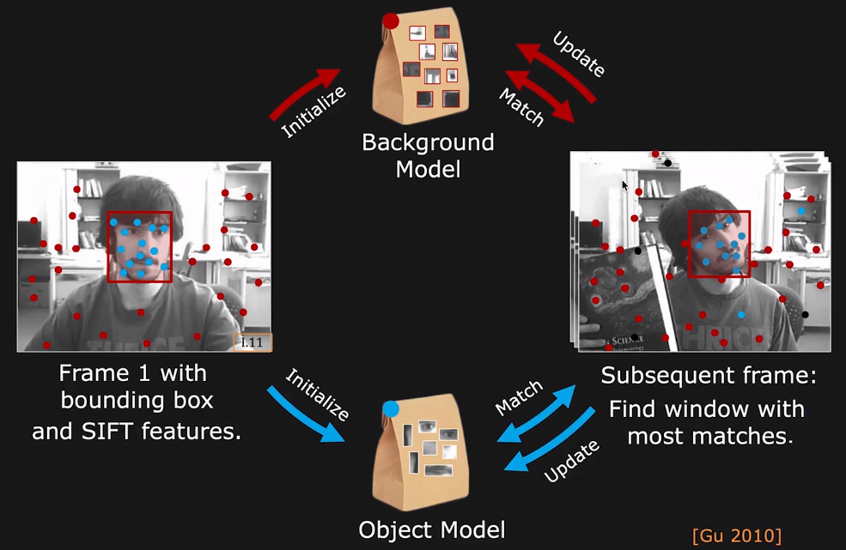
Tracking by Feature Detection

Slide 15
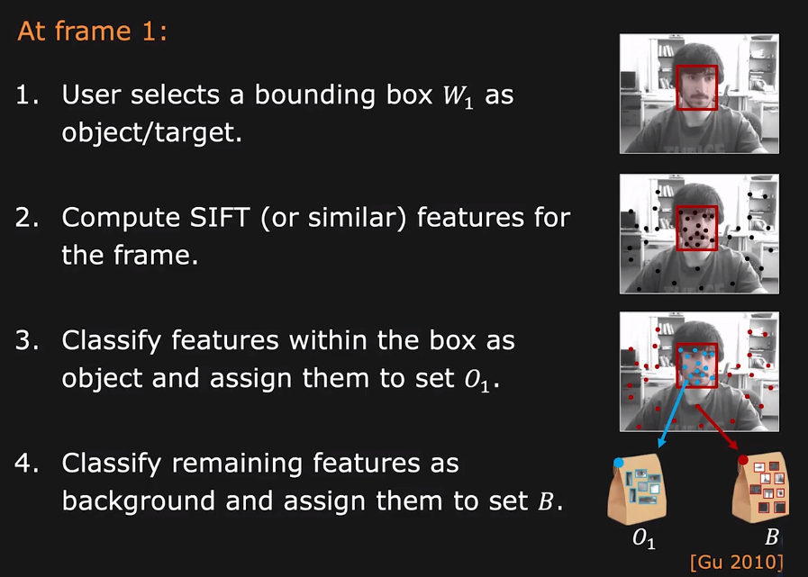
Tracking Initialization

Slide 16
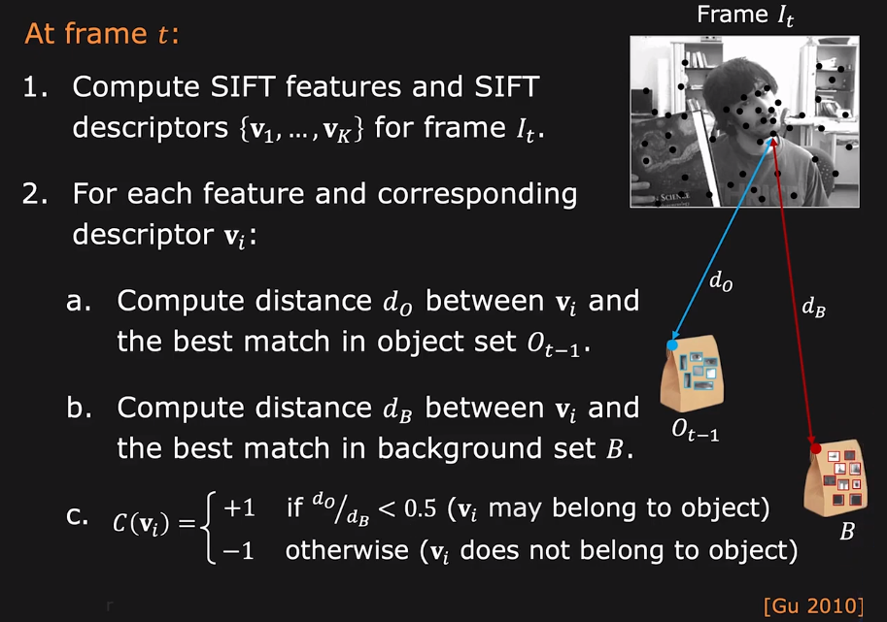
Object Tracking

Slide 17
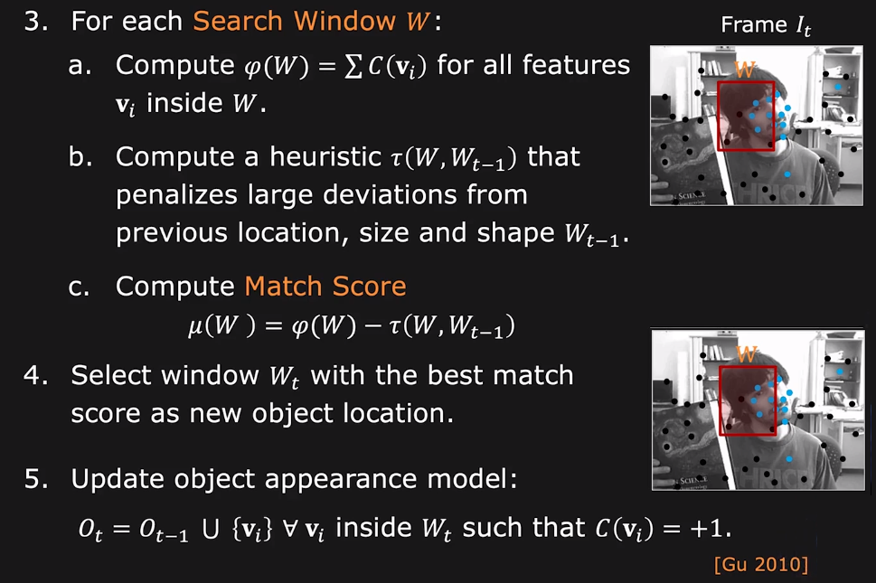
Object Tracking

Slide 18
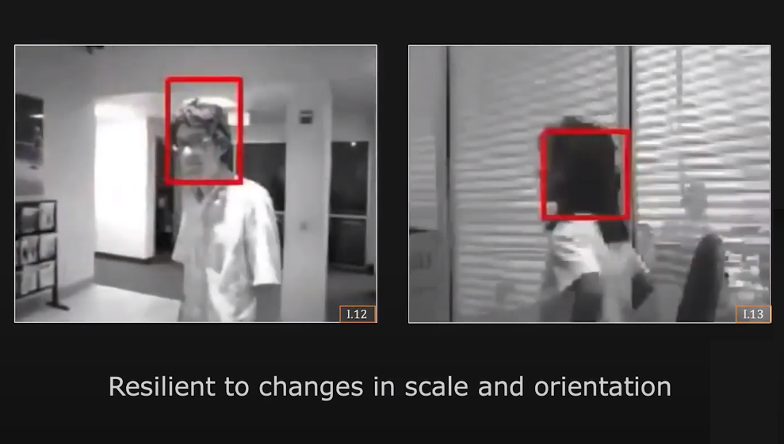
Tracking Results: Scale and Orientation

Slide 19
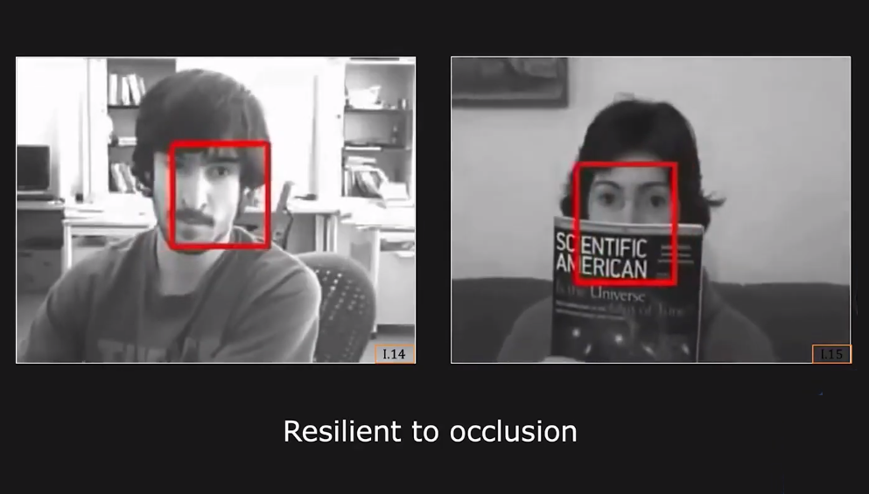
Tracking Results: Occlusion

Slide 20
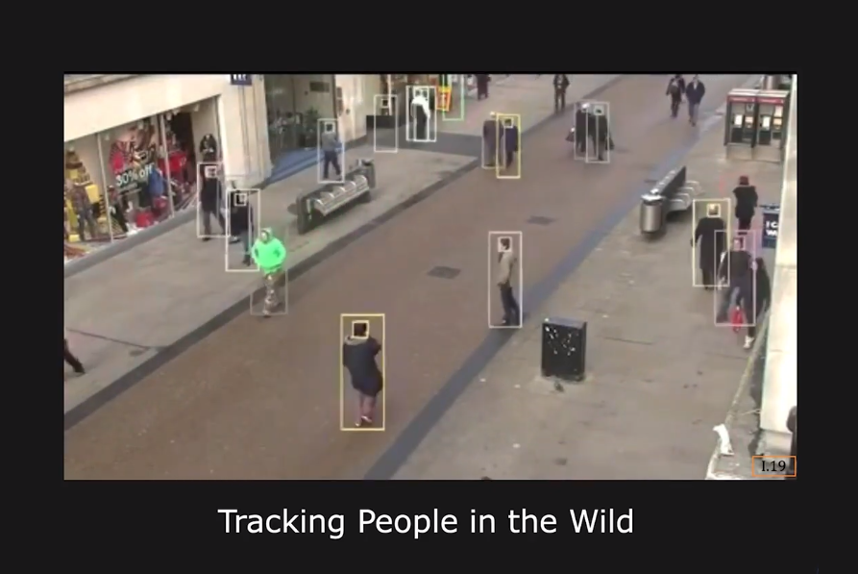
Tracking Applications

Slide 21
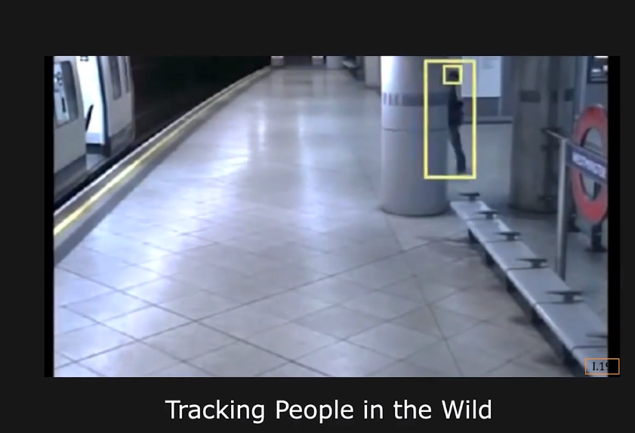
Tracking Results: Occlusion

Slide 22
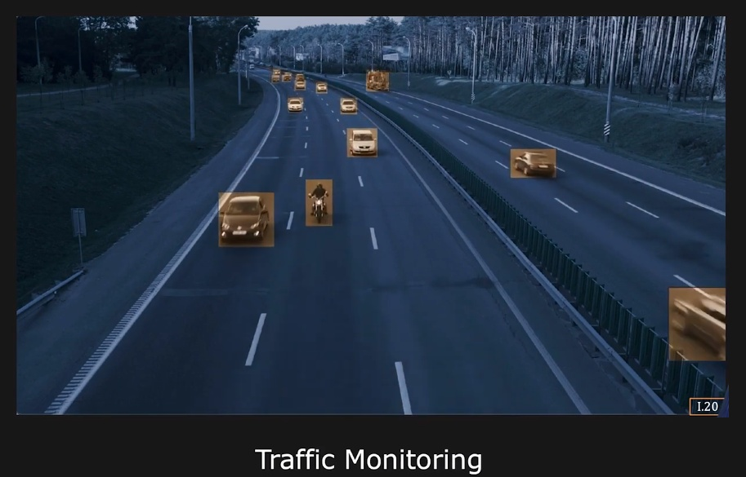
Tracking Results: Occlusion

Slide 23
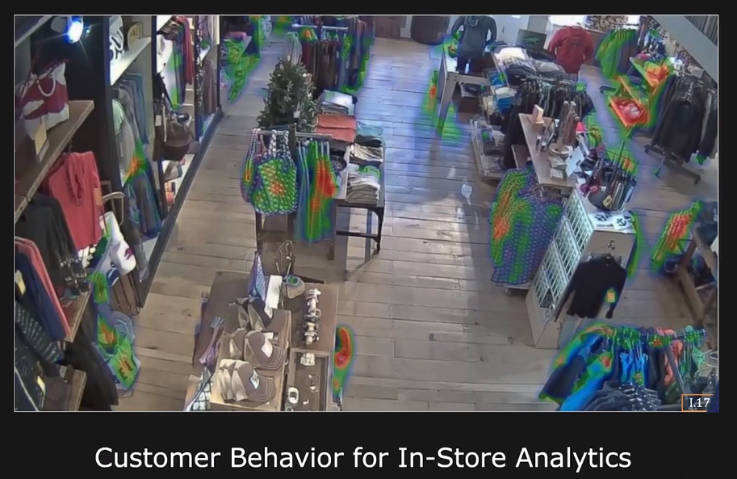
Tracking Results: Occlusion

Slide 24
Thanks

